Slide 1

Implicit Regularization in Gradient Descent
Yuan YAO
HKUST
Based on Tomaso Poggio, Nati Srebro, et al.

Slide 2
You might have reproduced this:
As iterations go, training error goes down to zero, but test error does not increase. Why overparametric models do not overfit here? -- Tommy Poggio, 2018

Slide 3
Overfit of test loss, Nonoverfit of test error!
Tommy Poggio, 2018

Slide 4
New challenges to understanding
Why?
Big (overparametric) models may have simple landscape of empirical risks, easy to find global optima (zero-training error), Joan Bruna et al.
Big (overparametric) models may generalize well: gradient based algorithms tend to find max margin models which generalize well, Srebro, Poggio et al.

Slide 5
Linear Regression Case

Slide 6
Implicit Regularization by GD/SGD in Linear Regression (1-layer Linear Network with Square Loss)

Slide 7
Minimal Norm Least Square solution

Slide 11
Proof.

Slide 12
Why Early Stopping?
GD asymptotically converges to minimal norm least square solution
The minimal norm least square may overfit the training data if it is noisy
Can we use early stopping as a regularization?
Yes, early stopping plays the same role as Ridge regression (Tikhonov regularization) [Yao-Rosasco-Caponetto’2005]

Slide 13
Those are regularization polynomials.

Slide 15
GD with Early stopping:

Slide 16
2-Layer Linear Networks

Slide 25
1-hidden layer polynomial network
Open: under what conditions, GD/SGD may find minimal norm global optima?

Slide 26
Summary
For overparametric multilinear networks (linear models) with square loss, for appropriate initial conditions, GD provides implicit regularization by evolving in a restricted strongly convex subspace (the column space of X’). Thus the asymptotic solution is the minimum norm global minima.
This is expected to be extended to multilayer neural networks with nonlinear activations, but precise characterization is open.
What about classification? For loss functions such as cross-entropy, GD on linear networks with separable data converges asymptotically to the max-margin solution with any starting point, while the norm diverges (Srebro et al., 2017). The convergence is very slow and only logarithmic in the convergence of the loss itself.

Slide 27
Binary Classification Problem

Slide 28
Cross-entropy Loss Landscape in Binary Classifications

Slide 29
The Perceptron Algorithm
Perceptron is a Stochastic Gradient Descent method:

Slide 30
Input ball:
Margin:

Slide 31
Finiteness of Stopping Time

Slide 32
Proof.

Slide 33
Proof (continued)

Slide 34
Proof (continued)

Slide 35
Proof (continued)

Slide 36
General Loss Functions

Slide 37
Binomial Deviance/Cross-Entropy/Logistic loss:
Exponential loss:

Slide 38
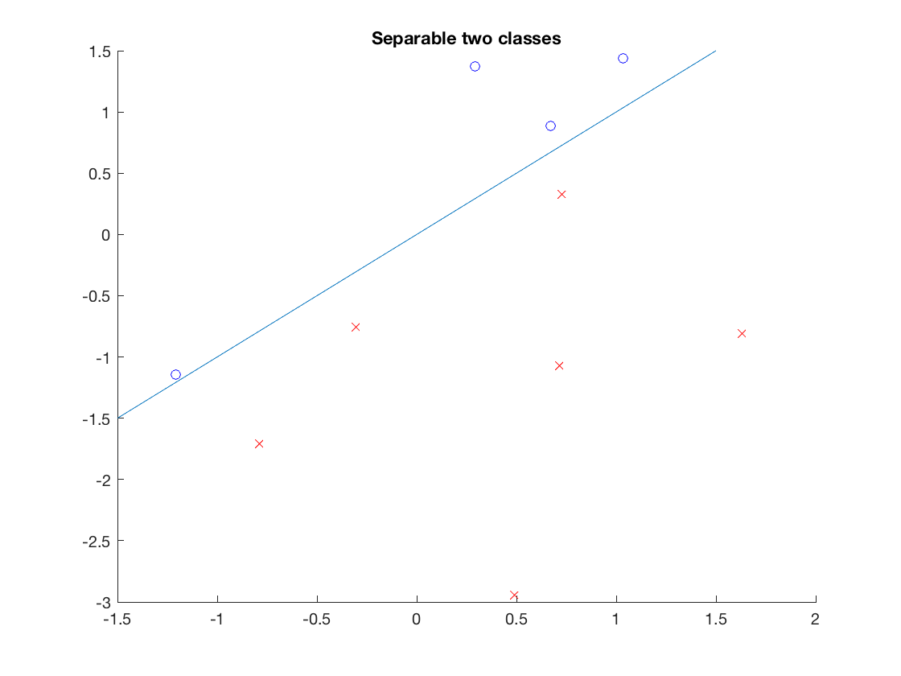
Separable Classification

Slide 39
Max-Margin Classifier (SVM)

Slide 40
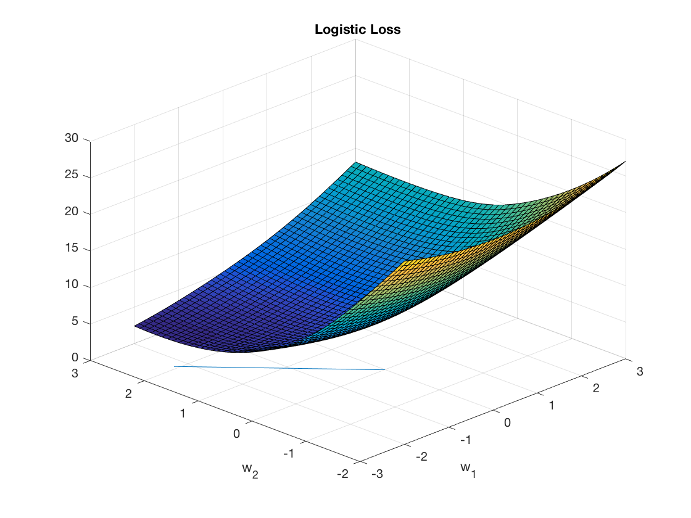
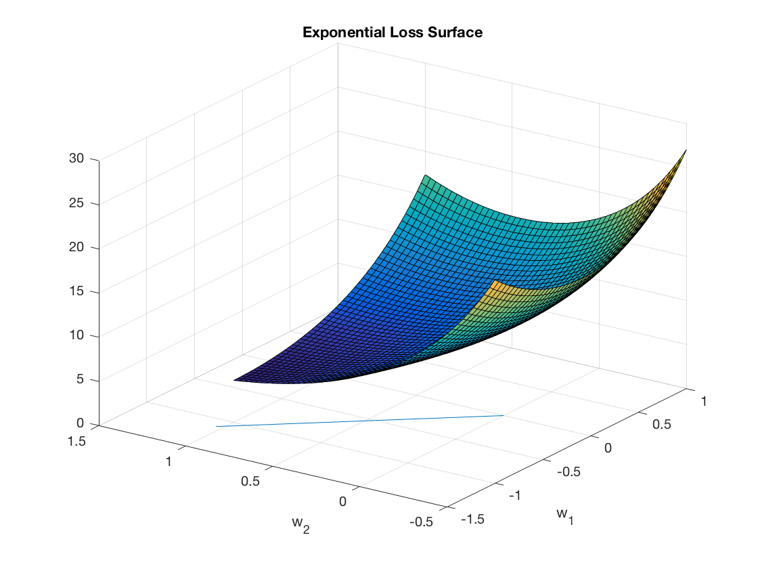
Landscape of Logistic/Exponential Loss
The minimizers are at infinity, asymptotically in the direction of max-margin classifier

Slide 44
Soudry et al. 2018

Slide 45
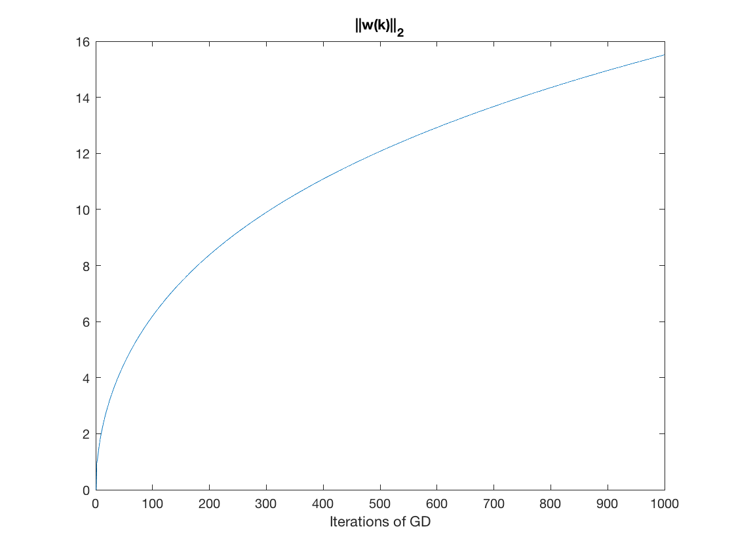
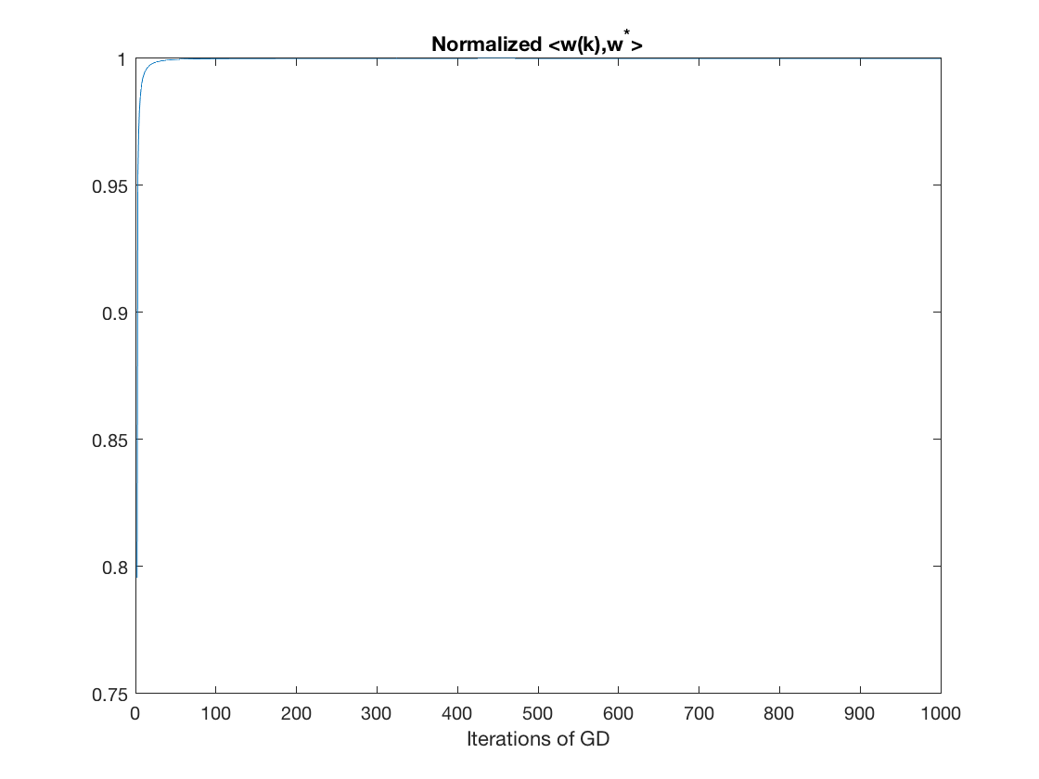
Separable Logistic Regression
Left: 2-norm grows ~ log t; Right: angle converges to max-margin classifier

Slide 46
Soudry et al. 2018

Slide 47
Open Problems
Any rigorous theory on general GD for multilayer neural networks with nonlinear activations?
Non-separable case?
Early stopping regularization in deep neural networks?

Slide 48
Thank you!

